Slide 1
Upgrading from
Skype for Business to Microsoft Teams
Jethro Seghers
Senior Customer Program Manager
@jseghers – jesegher@microsoft.com

Slide 2
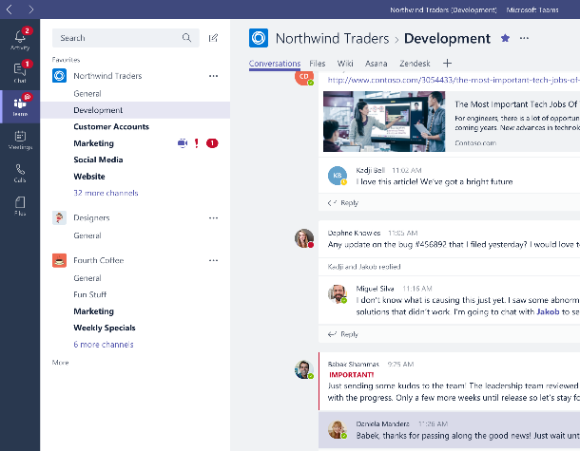
Microsoft Teams
The hub for teamwork in Office 365

Slide 3
Why upgrade to Teams?
Teams is used in
500,000+
companies
  Advanced features and capabilities
    Teams can do more than Skype for Business Online
    Rapid innovation based upon a rich Intelligent Communications roadmap
91
of Fortune 100
  Modern user experiences
    State-of-the-art cross-platform and mobile experiences
    Collaboration across Teams and Channels
60 companies with 10,000+ users
  Performance by design
    Re-imagined client built on cloud infrastructure
    Teams provides improvements in quality and operational metrics
Teams is the fastest growing business app in Microsoft history
Notes:
Rapid innovation delivering our rich Intelligent Communications roadmap - We have delivered on our published Skype for Business to Microsoft Teams roadmap, first shared at Microsoft Ignite 2017
Teams is the fastest growing business app in Microsoft history.
At Ignite 2018 we shared the latest usage numbers that show the accelerated use and adoption of Teams.
Since bringing in Skype for Business workloads for meetings and calling, Microsoft Teams has become the single communications and collaboration application in Office 365.
As we look to transition Skype for Business Online organizations over to Microsoft Teams, it’s important to note the value that Microsoft Teams can bring to organizations—big and small , such as:
Broader communication and collaboration functionality
Modern user experiences across platforms and devices
Cloud infrastructure for improved performance and operational metrics

Slide 4
Skype to Teams Roadmap: delivered
Bold items represent features previously only found in Skype for Business Server
 | Available today
 | 1:1 to Group Call Escalation with Teams, Skype for Business, and PSTN participants Anonymous Join Audio Conferencing in over 90 countries Blind Transfer Boss and Delegate Support Broadcast Meetings (preview) Call Blocking Call Forwarding Call Queues Call Park Caller ID Masking Cloud Recording | Consultative Transfer Direct Routing (Hybrid connection to Teams) Distinctive Ring Do not Disturb breakthrough e911 Support Enable Existing Calling Plan Support Extension Dialing Federated Meetings Forward to Group Group Call Pickup Hide/Share/Mute Chat Hold | Improved Device Selection Interactive Troubleshooting Large Meeting Support (~250) Lobby for PSTN callers Lobby Support Location-Based Routing (preview) Multi-call Handling Mute Other Participants Organizational Auto-Attendant Out of Office Support Participant Management Persistent 1:1 and Group Conversations Private and Channel Meetings | PSTN Fallback Safe Transfer Schedule in Outlook & Teams Shared Line Appearance Simultaneous Ringing Speed Dial Suggested Contacts Team + Channels for Teams Productivity Transfer to PSTN Call User Facing Diagnostics Voicemail
 | Application Sharing Conversations | Desktop sharing Enable Meeting Lifecycle with Pre/During/Post | Give and Take Control in Sharing Immersive Meeting Experiences | PowerPoint Load and Share Whiteboard and Meeting Notes
 | Contact Groups Federated Chat between Teams and Skype for Business | Guest Access for External Users Import Contacts from Skype for Business | SfB-Teams Calling Skype for Business Interop with Persistent Chat | Teams-SfB 1:1 Chat Interop Unified Presence
 | Cloud Video Interop services Edge, Chrome Browser Support for meetings | iOS and Android support Skype Room Systems Support Surface Hub Support | Support for existing certified SIP Phones Trio 1 Touch Teams Meeting Join | TTY Support USB HID control
 | Call Quality Diagnostic Portal eDiscovery/Hold/Archiving of Messages Enable Call Quality Analytics | Message Retention Policies Messaging Interop IT Policies | Messaging User-Level Policies SfB-Teams Interop Policies | Tenant Policies User-Level Meeting Policy
Enterprise grade
Collaborative meetings
Skype for Business Interop and federation
Platform and devices
IT Pro

Slide 5

“
Teams has a real impact
“Teams is helping people to work more efficiently and establish relationships with colleagues around the world. The potential of this tool coupled with the desire of our team to build strong partnerships and simplify the way we work is a powerful combination that will surely enhance collaboration on a global scale.”
“The new way our packaging solutions teams in Mexico and Texas are working together is a perfect example of how Teams can simplify cross-regional collaboration. By using Teams to chat they can communicate in their preferred language and the recipient can translate the message with a click of a button.”
“[Teams] has improved the way we do a lot of things, including managing projects, but the biggest advantage is streamlining process confirmations. I estimate that by having the process confirmation form accessible to everyone in a centralized, online location, the 20-minute process has been reduced to a few minutes.
”

Slide 6
Charting your journey to Teams.

Slide 7





Journey from Skype for Business to Teams
For organizations already using Teams
ROUTE
1
Plan your upgrade to Teams Only
Upgrade to Teams Only
Coexistence
+
1
2
“Islands” mode (side-by-side) when:
Teams Collab or Collab+Meetings when:
Skype for Business Online and most on-premises (recommended path)
Desire to quickly move to Teams
Users can handle two-client setup
More complex organizational environment (on-premises and hybrid)
Expect a long co-existence period
Wish to avoid overlapping UC features
Third-party integration points
Notes:
If your organization is already using Teams alongside Skype for Business, whether in Islands Mode, Skype for Business with Teams collaboration, or Skype for Business with Teams collaboration and meetings, you’re close to making the upgrade to a Teams Only, single-client experience.
Coexistence is the presence of both Skype for Business and Teams in the Journey from Skype for Business to Teams.
Supported coexistence configurations for Skype for Business and Teams
Skype for Business or Teams Only
Skype for Business and Teams – Islands
Combination (but no overlap) of functions across both
Customer deployments can involve multiple modes at different times

Slide 8
Journey from Skype for Business to Teams
For organizations not yet using Teams
ROUTE
2
Envision teamwork for your organization
Pilot Teams
Deploy Teams
Coexistence
Adopt Teams
Plan your upgrade to Teams Only
Upgrade to Teams Only
+
1
2
3
4
5
6
“Islands” mode (side-by-side) when:
Teams Collab or Collab+Meetings when:
Skype for Business Online and most on-premises (recommended path)
Desire to quickly move to Teams
Users can handle two-client setup
More complex organizational environment (on-premises and hybrid)
Expect a long co-existence period
Wish to avoid overlapping UC features
Third-party integration points
Notes:
URL on modes: https://docs.microsoft.com/en-us/microsoftteams/migration-interop-guidance-for-teams-with-skype
If you’re still planning your organization’s journey from Skype for Business to Teams, we’re here to help take the guesswork out of your upgrade journey. We’ve employed a proven success framework for driving change, incorporating guidance, tips, and resources throughout.
Coexistence is the presence of both Skype for Business and Teams in the Journey from Skype for Business to Teams.
Supported coexistence configurations for Skype for Business and Teams
Skype for Business or Teams Only
Skype for Business and Teams – Islands
Combination (but no overlap) of functions across both
Customer deployments can involve multiple modes at different times

Slide 9
Teams upgrade paths.

Slide 10
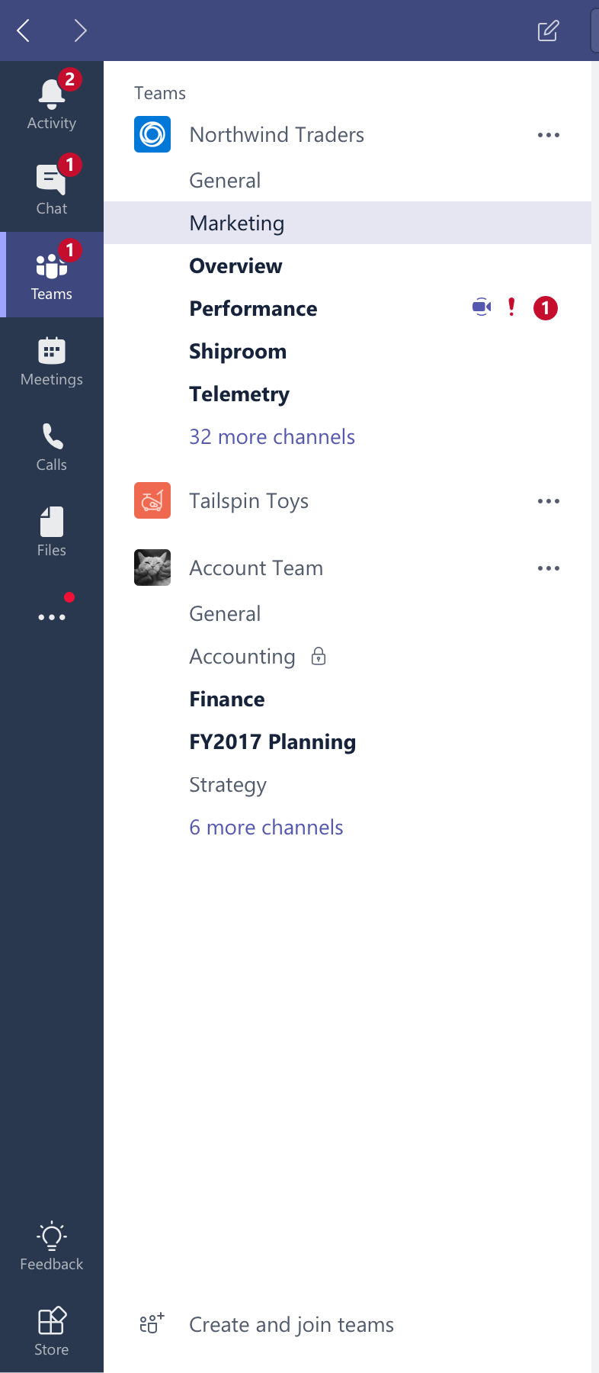
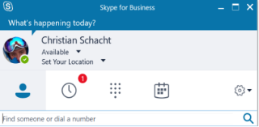

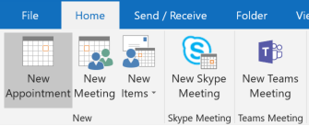

Islands mode: Teams and Skype for Business run side-by-side
  Chat and Calling
    Users can initiate calls and chats from either client
    Incoming VOIP calls and chats land in same client as originator
    Presence is separate
    No interoperability
    Meetings
Users can schedule meetings from either client
Outlook shows both add-ins
End user can join meetings from the respective clients
Skype for Business Online customers should start with Islands mode so users can experience the full functionality of Teams at their speed. Once organization adoption of Teams hits 100% saturation, move to Teams-Only mode.
Notes:
Skype for Business Online customers should start with Islands mode so users can experience the full functionality of Teams at their speed. Once organization adoption of Teams hits 100% saturation, move to Teams-Only mode.

Slide 11
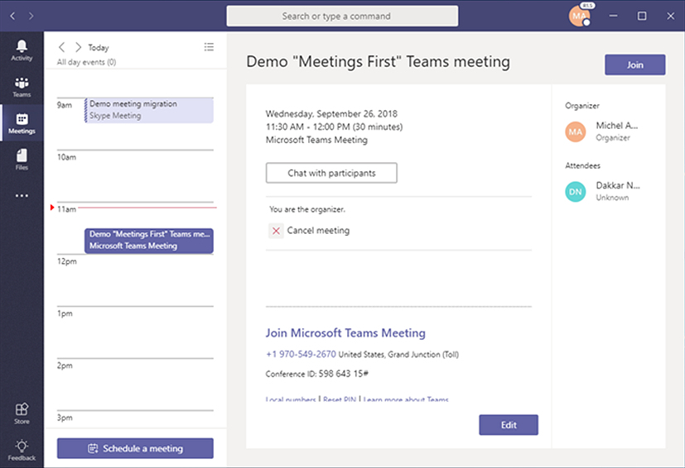
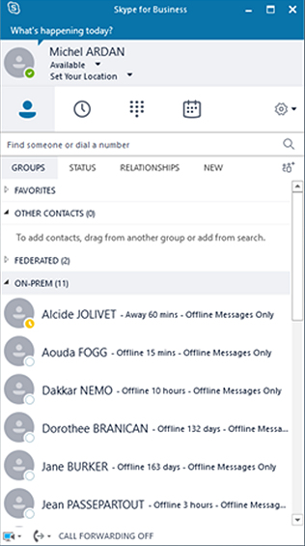
Meetings First: move meetings workload to Teams first
  Skype for Business Server for Chat and Calling
  Address meetings, then Enterprise Voice and Chat
  Simplifies and streamlines a meetings-centric Teams experience
  Teams for Meetings
  Provides richest meetings experience
  Includes meeting rooms, devices, and services (Cloud Video Interoperability)
  Skype and Teams co-exist
  Teams and Skype for Business clients play nice with each other
  Skype for Business meetings are now Teams meetings
  IT benefits include ease with provisioning and reporting in a single location
Notes:
Transitioning meetings workloads first (Meetings First) enables on-premise organizations to benefit from Teams meeting functionality in the event they are not yet ready to move calling to the cloud.

Slide 12
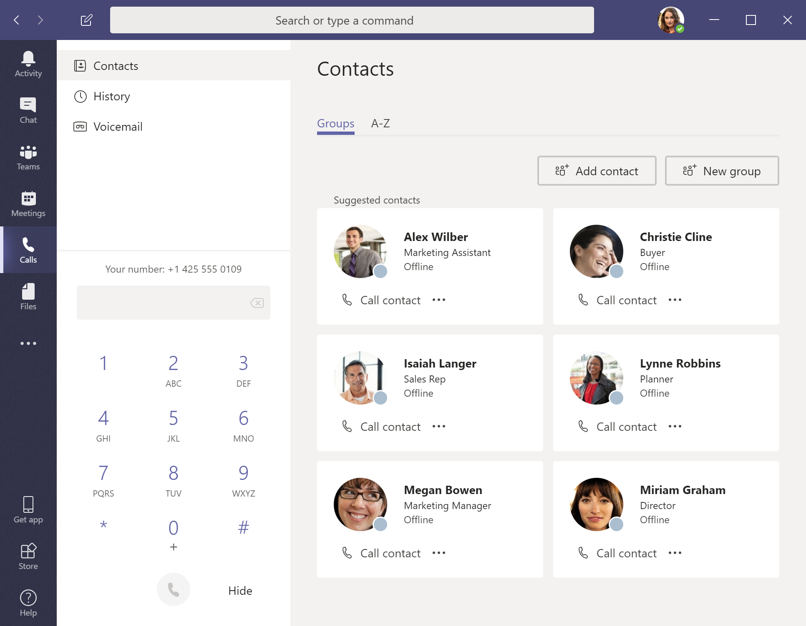
Teams Only mode: Teams is used for everything
  Chat and Calling
    Receive and initiate all chats and calls in Teams
    Interop (IM/call) with any Skype for Business user
    Redirects to Teams if users try to sign in to Skype for Business.
    Meetings
    Newly scheduled meetings take place in Teams
    Previously scheduled Skype for Business meetings still happen in Skype for Business
    Data that gets migrated
    Existing contacts from Skype for Business including federated
    Existing meetings
Notes:
In Teams Only mode, teams is used for everything, from Chat and Calling to Meetings, to Collaboration in Teams and Channels.

Slide 13
Meetings scenarios
Meeting client must match the service that hosts the meeting
Users can always use either meeting client, whether upgraded or not
  Skype for Business client required to join Skype for Business meeting
  Teams client required to join Teams meeting
  Skype for Business user can always use a Teams client to join a meeting organized by a Teams user
  Teams user can always use a Skype for Business client to join a meeting organized by a Skype for Business user
Meeting client above indicates all types of clients, including desktop (PC/Mac), mobile (iOS/Android), Browser (Edge/Chrome for Teams), Skype Meeting App

Slide 14
User Experiences

Slide 15
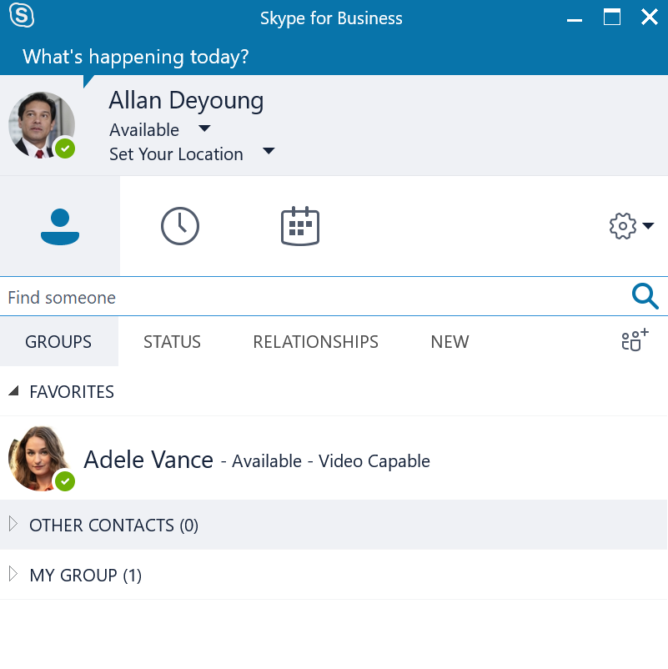
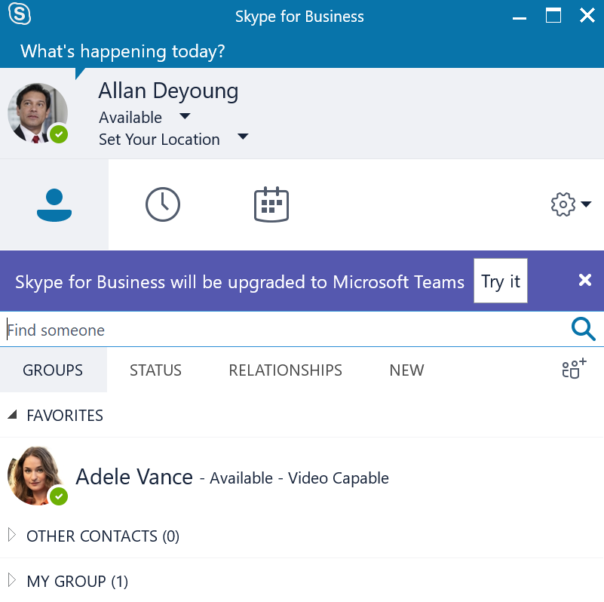
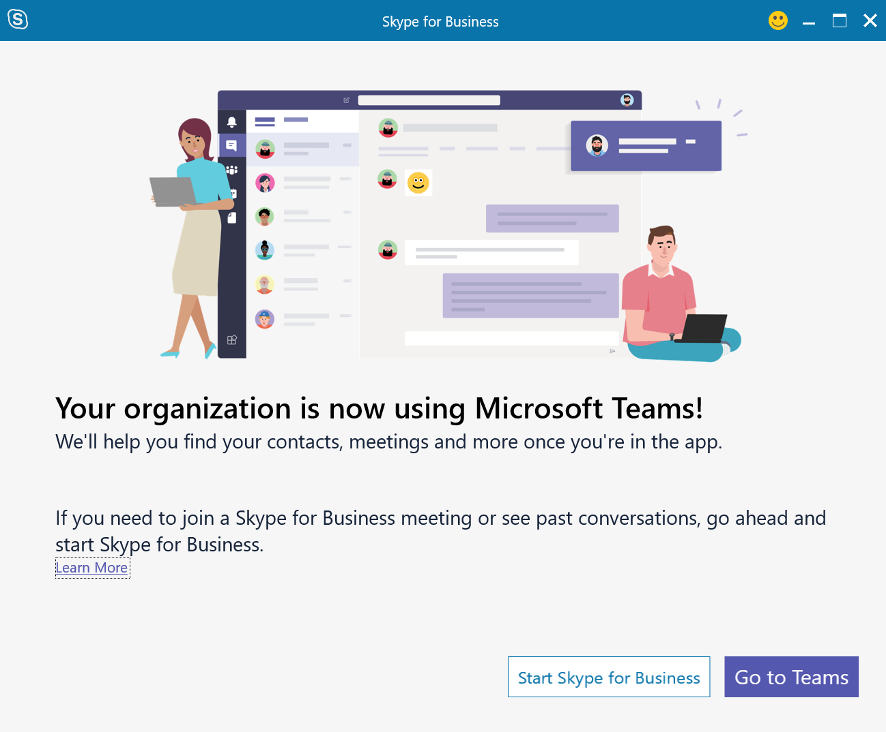
Skype for Business Client upgrade experience
What users will see at each phase
No upgrade
Teams Notification
Skype for Business upgraded to Teams
Skype for Business client remains the same
Teams is installed and ready to be used. User will be offered notification to try Microsoft Teams
Skype for Business Outlook Meeting add-in is removed and Skype for Business integrations with Office are disabled. Current Outlook Contact Card now maps to Teams

Slide 16
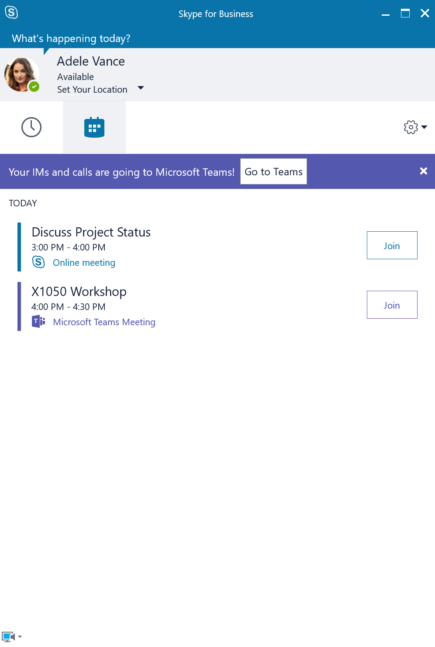
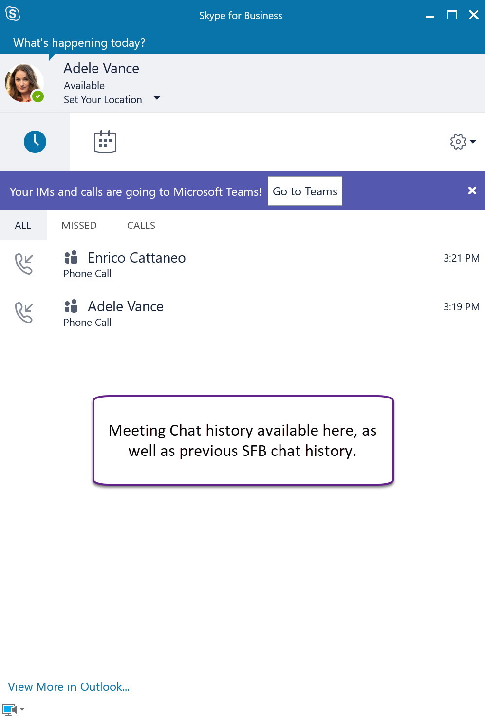
Windows Desktop: Teams Only experience
Meetings-Only App (Nov C2R)
Teams Only
Meetings
Meeting Chat

Slide 17
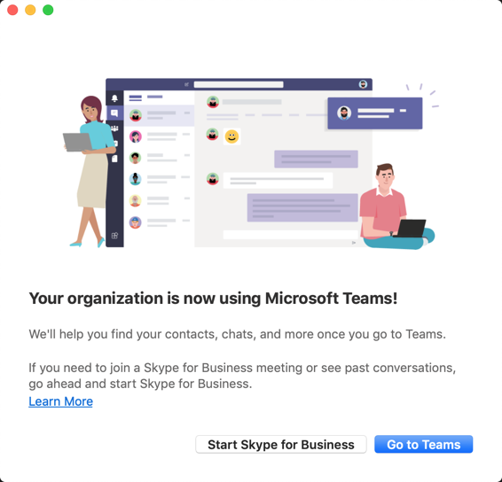
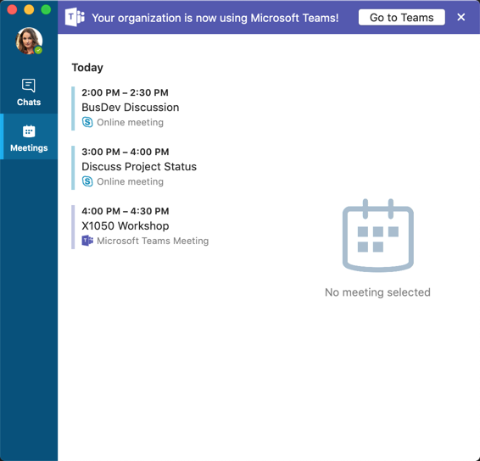
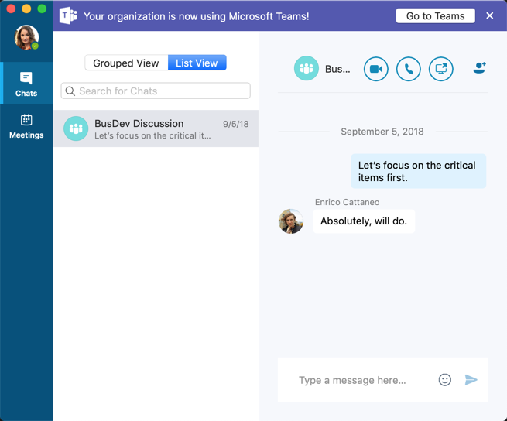
Skype for Business on Mac: Teams Only experience
Meetings-Only App (16.21+)
Teams Only
Meetings
Meeting Chat

Slide 18
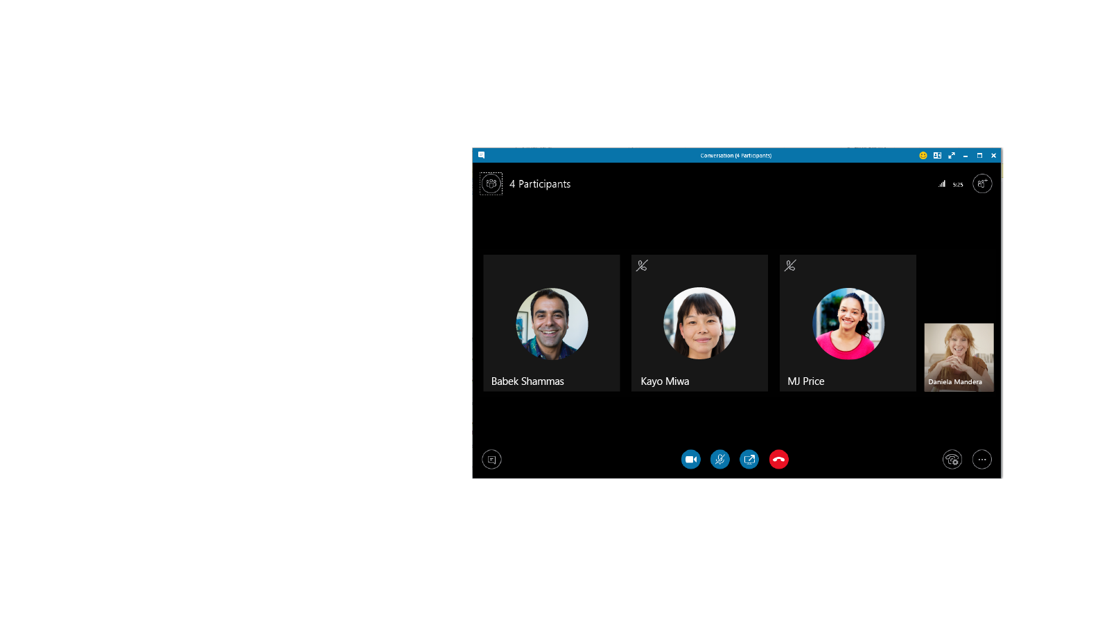
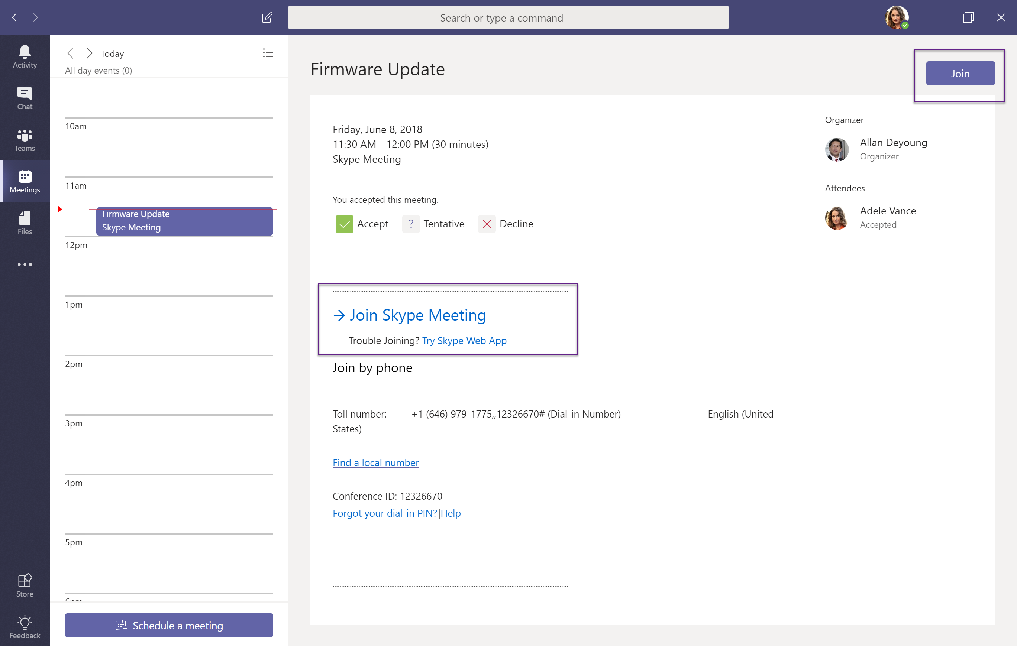
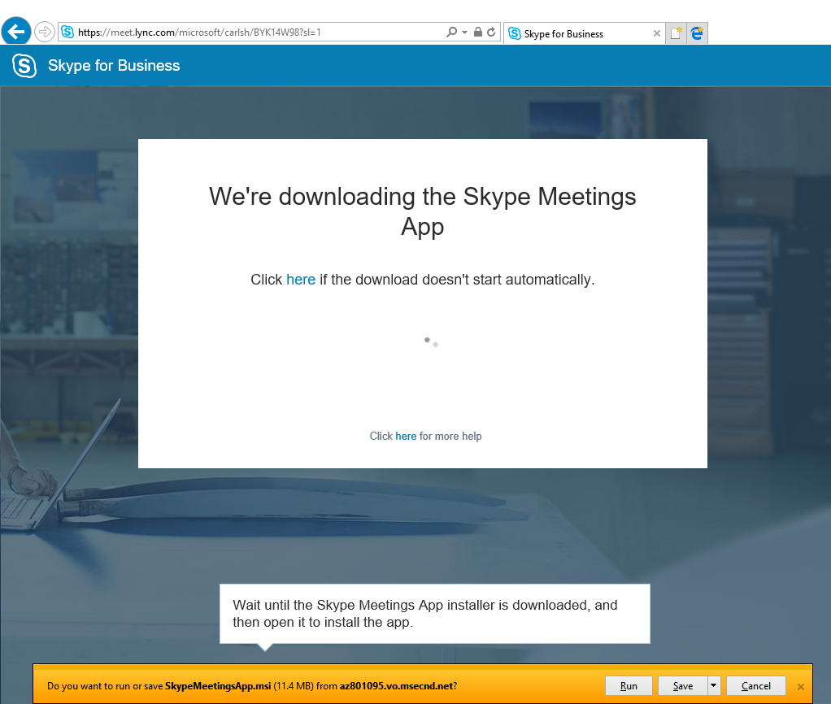
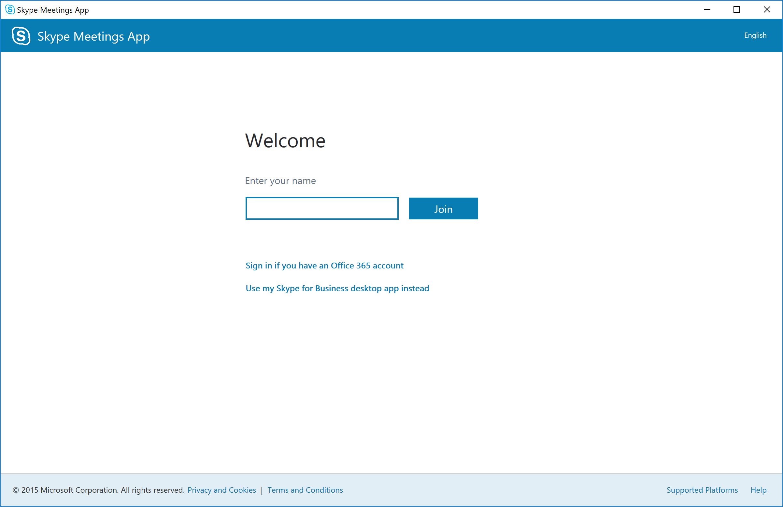
Skype for Business Meeting join experience: from Teams
Native limited client: Skype for Business client launched with meetings only functionality
All future meetings launch
Skype Meeting App
Web client:
requires one-time download and install of Skype Meetings App

Slide 19
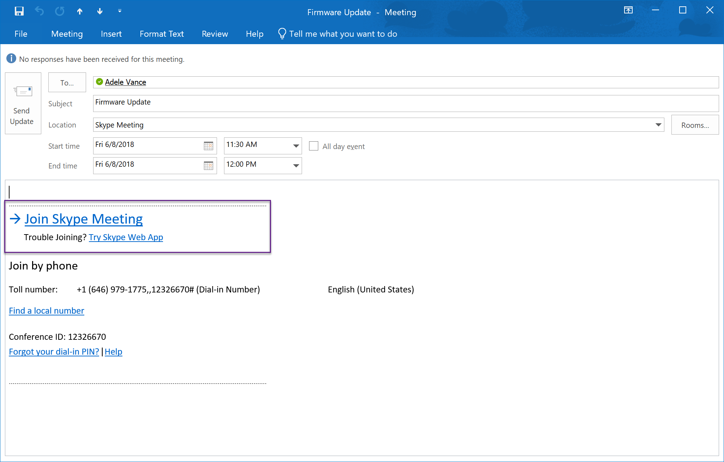
Skype for Business Meeting join experience: from Outlook
Native limited client: Skype for Business client launched with meetings only functionality
All future meetings launch
Skype Meeting App
Web client:
requires one-time download and install of Skype Meetings App

Slide 20
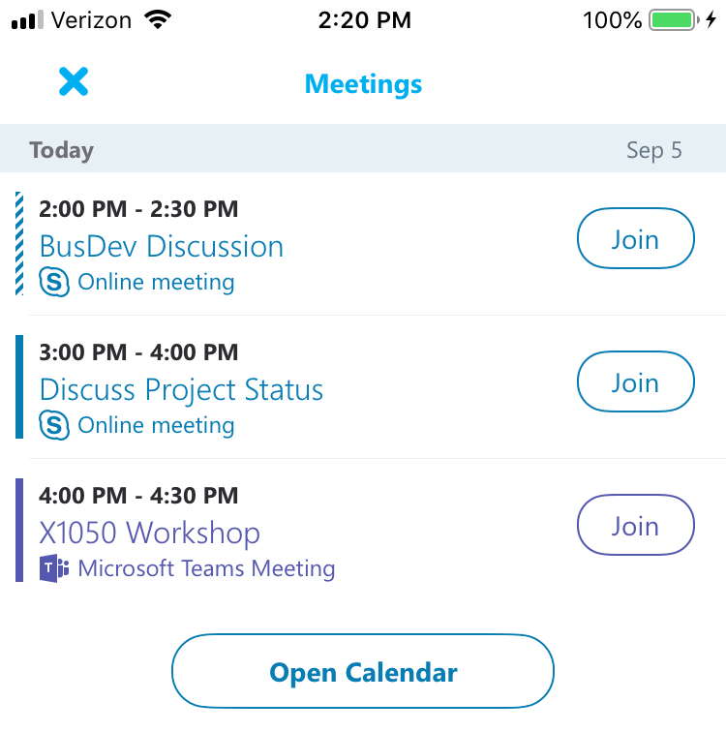
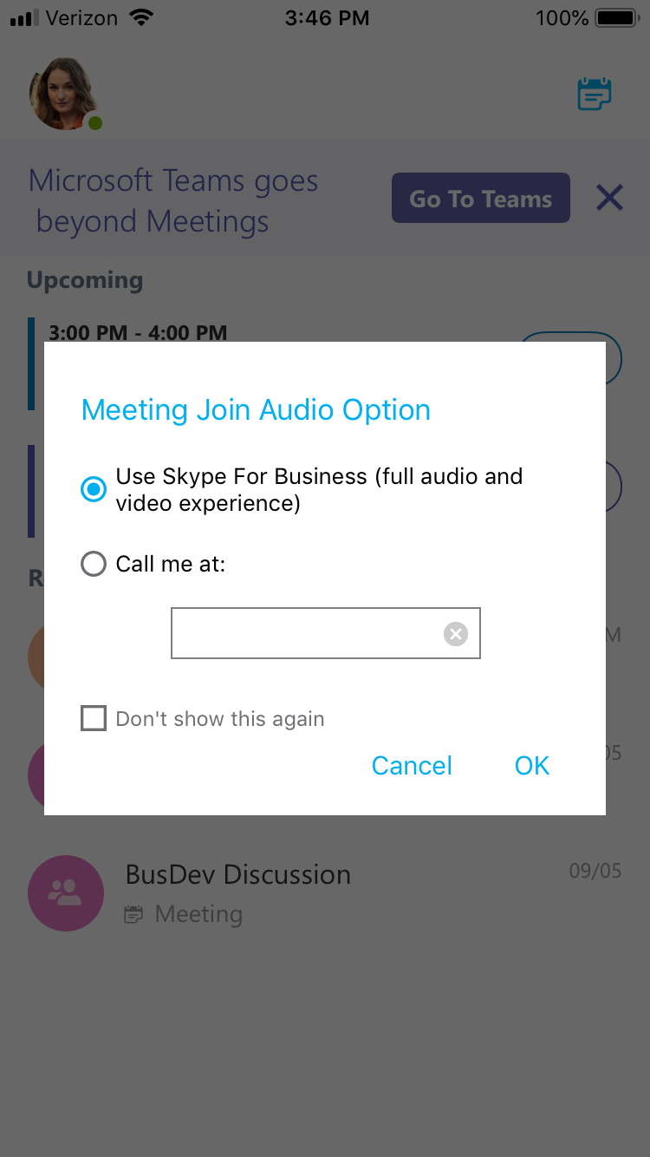
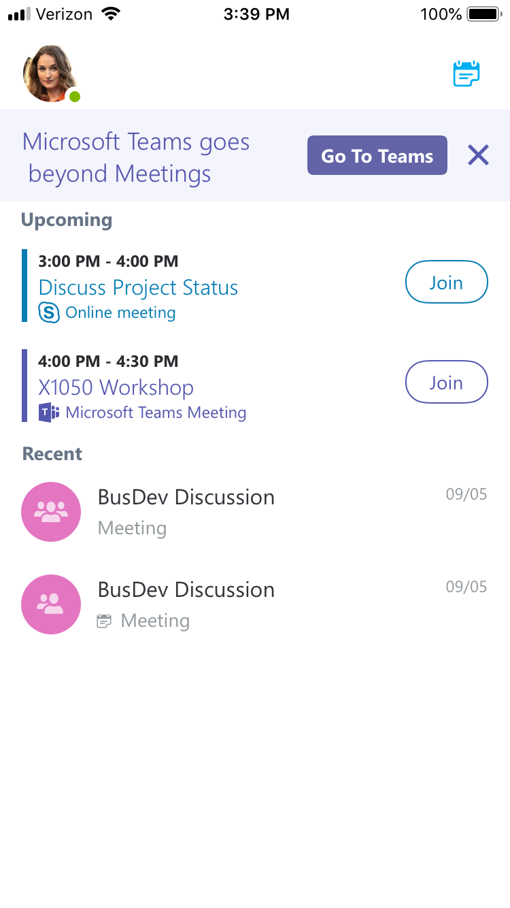
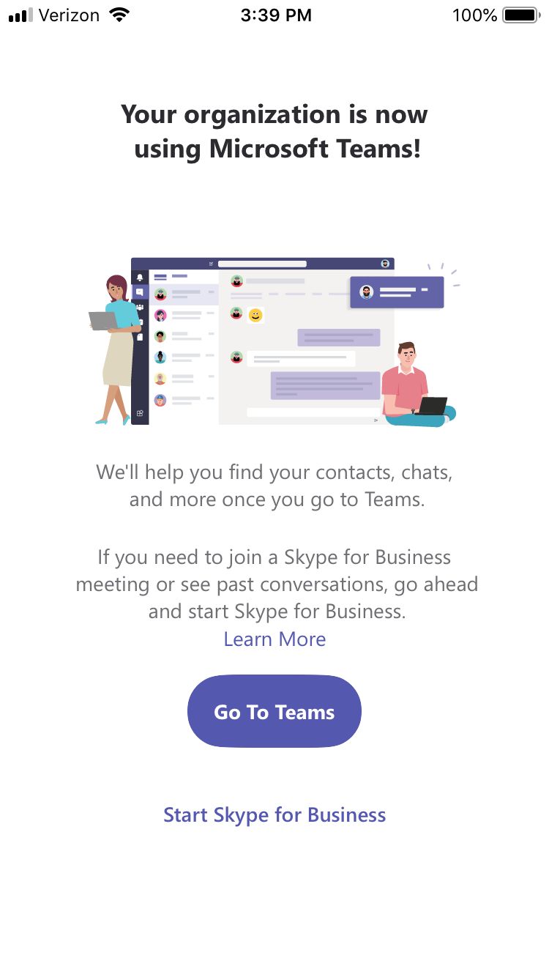
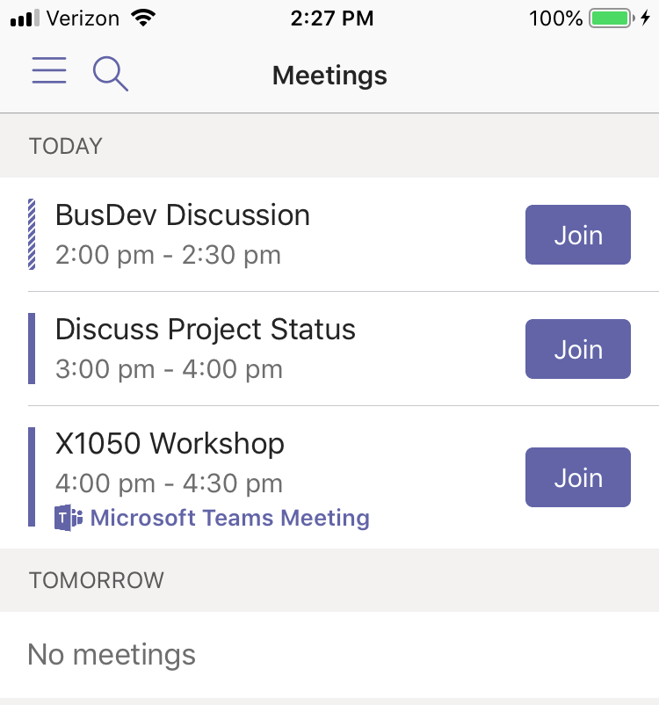
Mobile Join (iOS)
Join meeting from Skype mobile, Teams mobile app or Outlook Meeting Invite (not pictured)

Slide 21
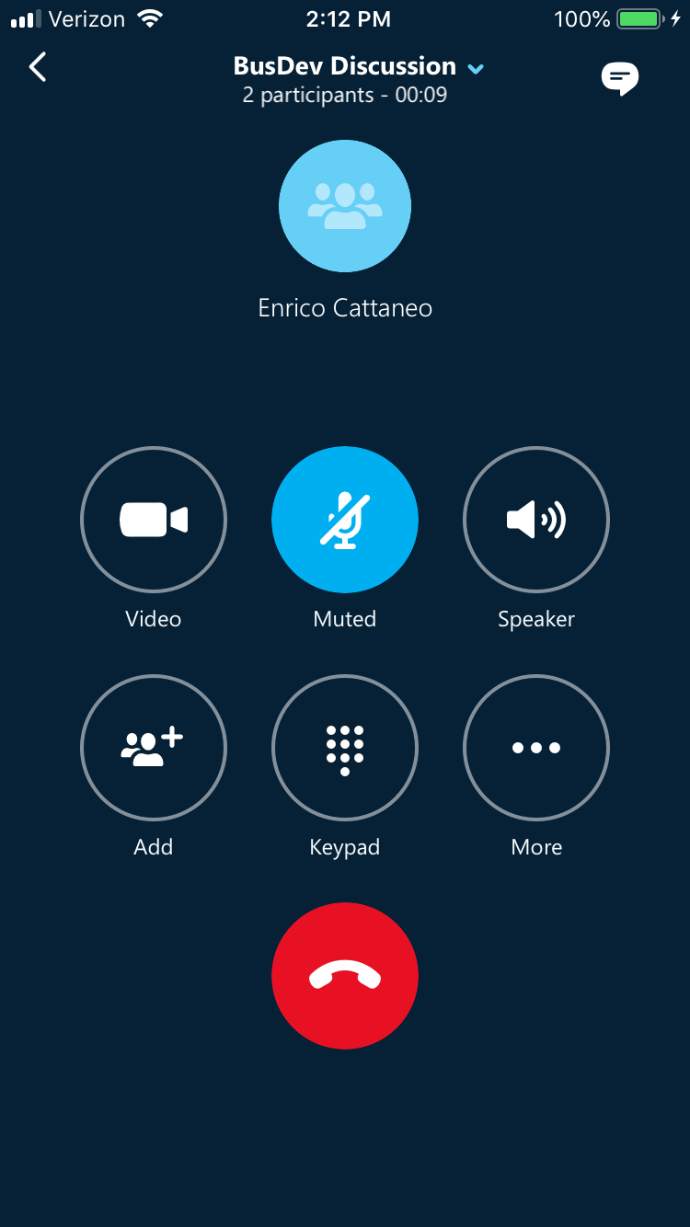
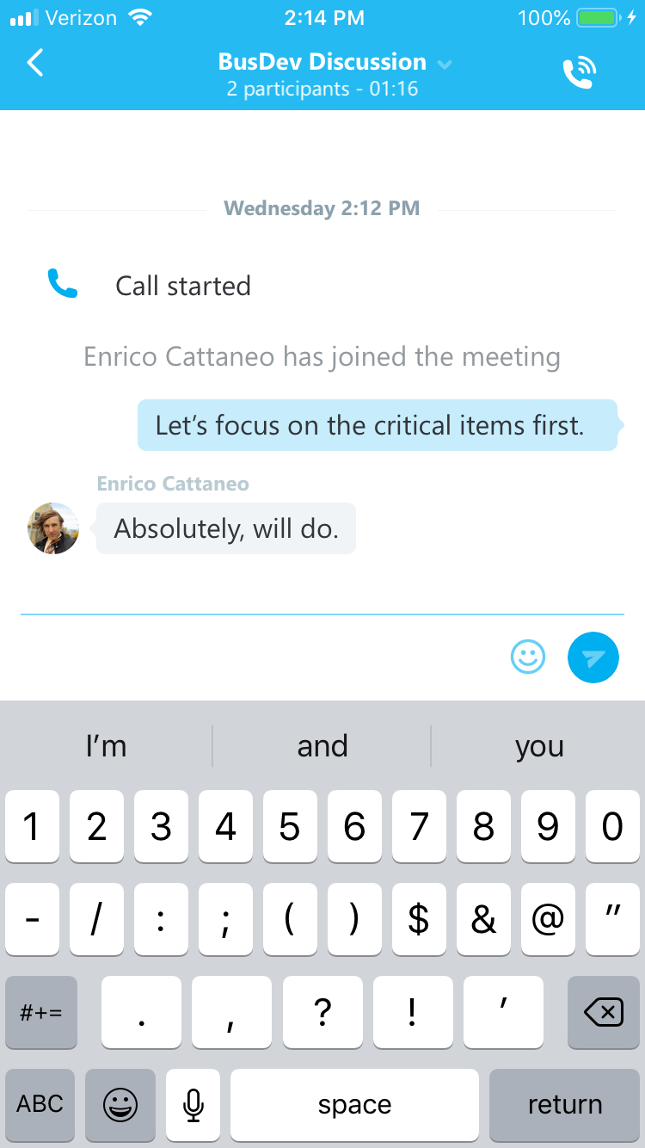
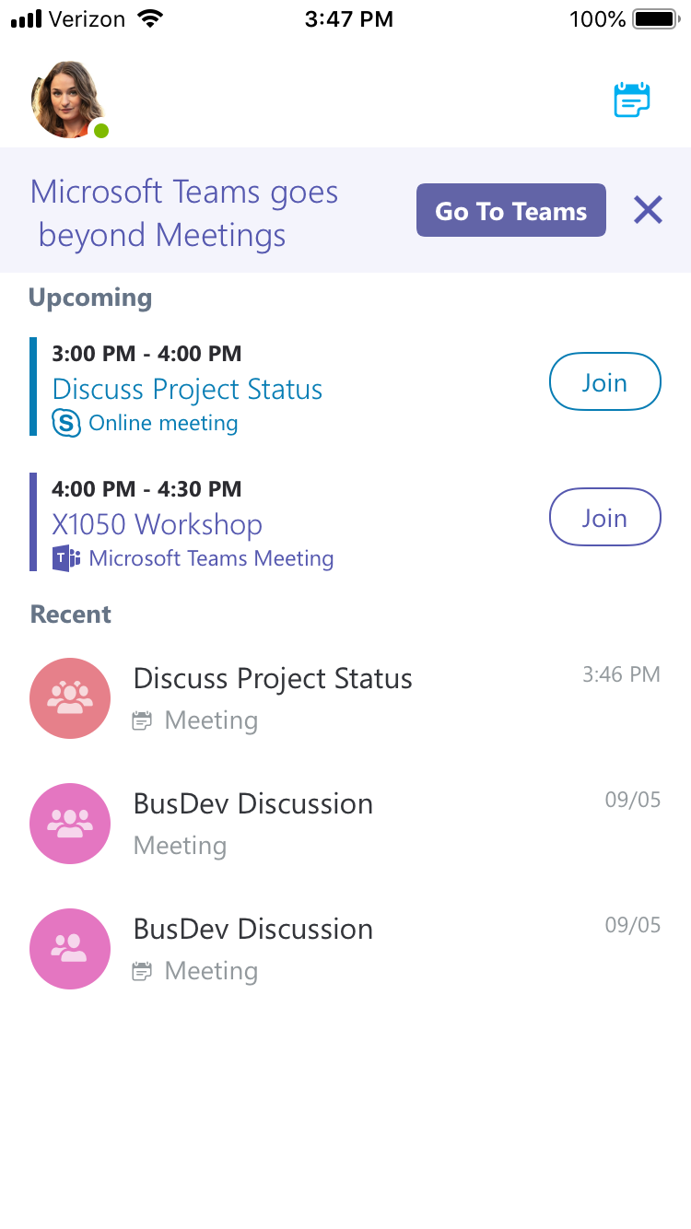
Mobile Join (iOS)
Meeting chat history available.

Slide 22
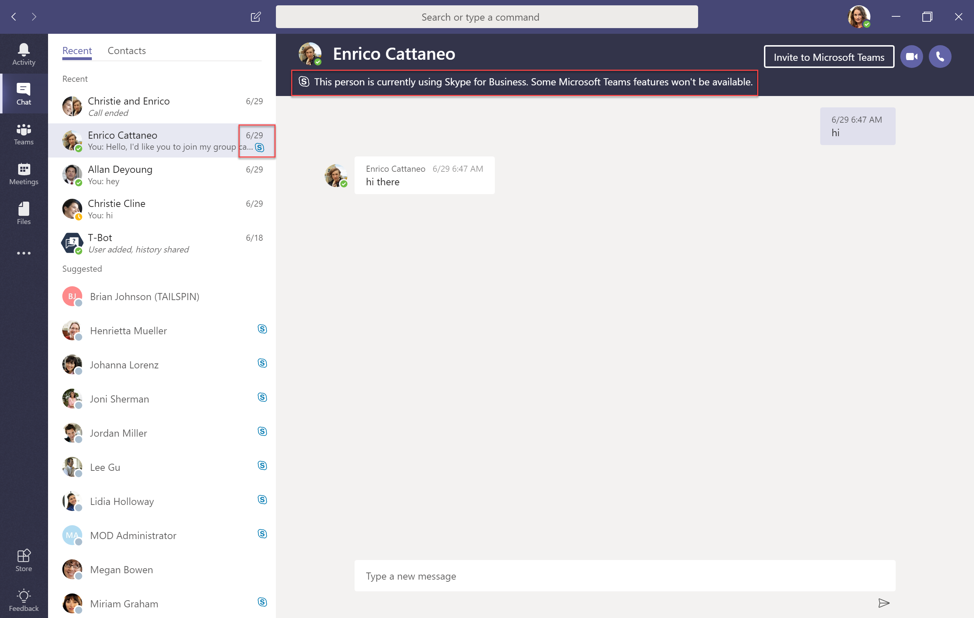
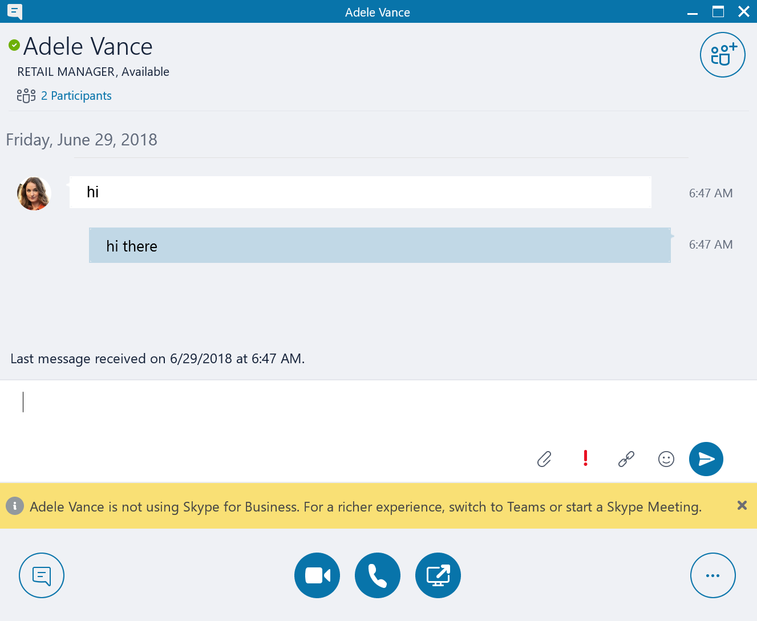
Native Interop (chat)

Slide 23
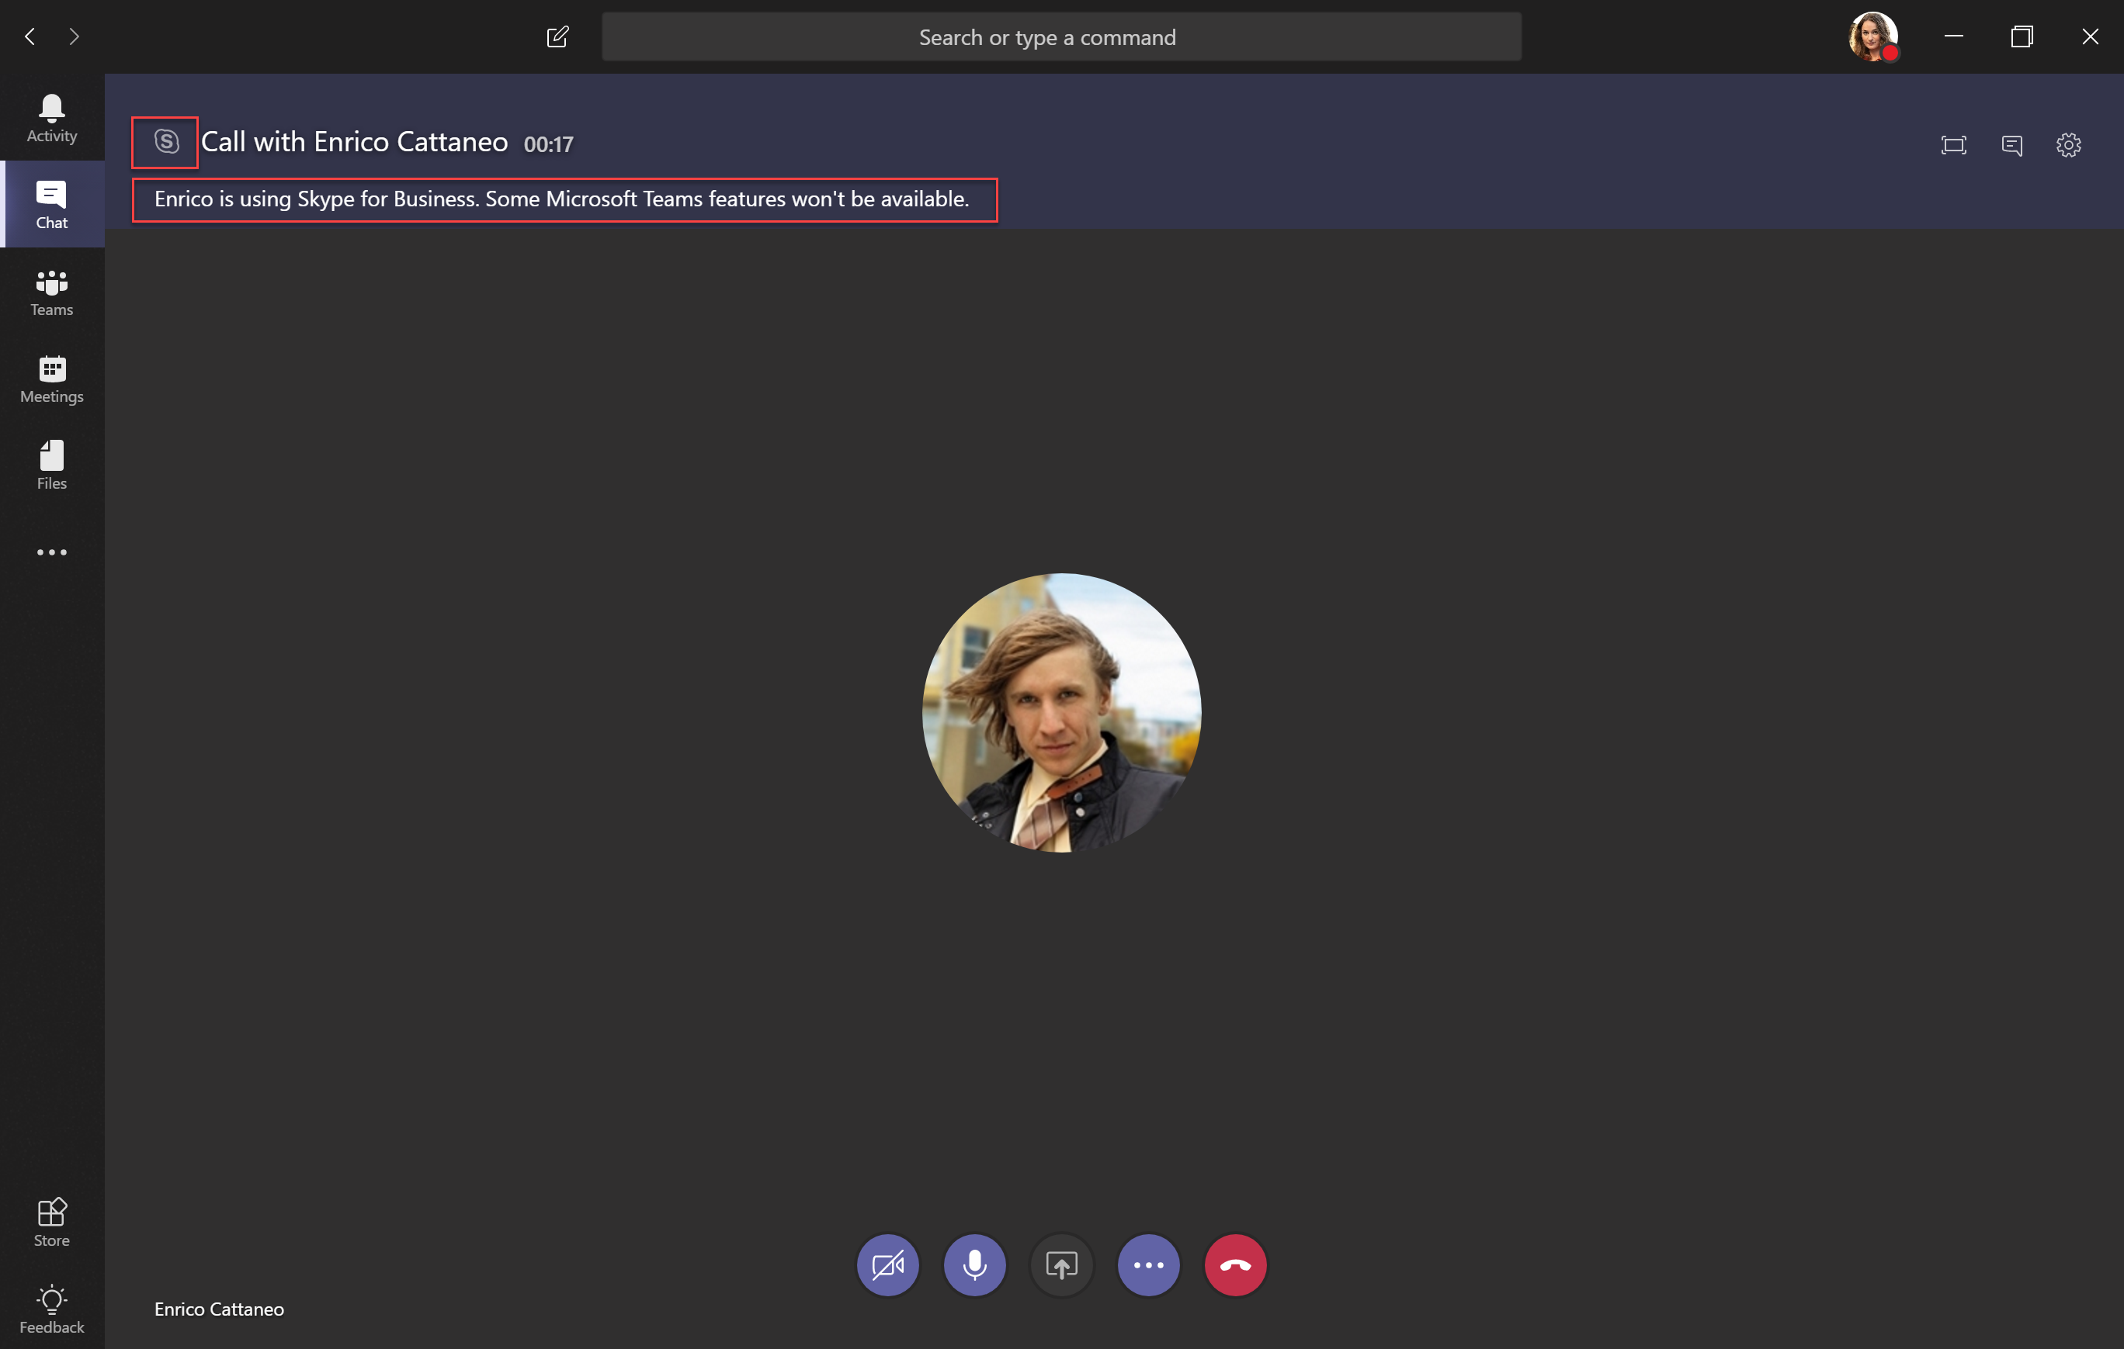
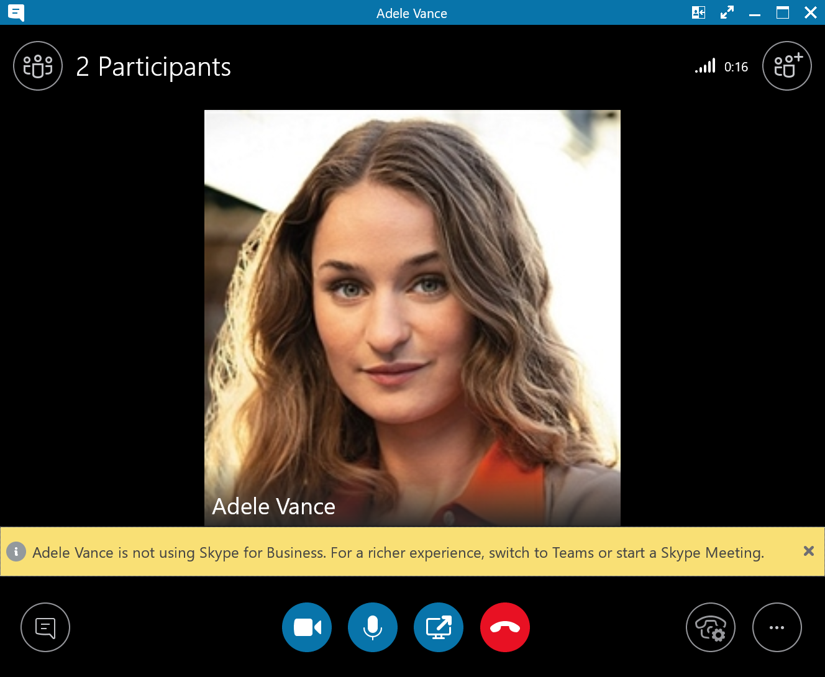
Native Interop (calling)

Slide 24
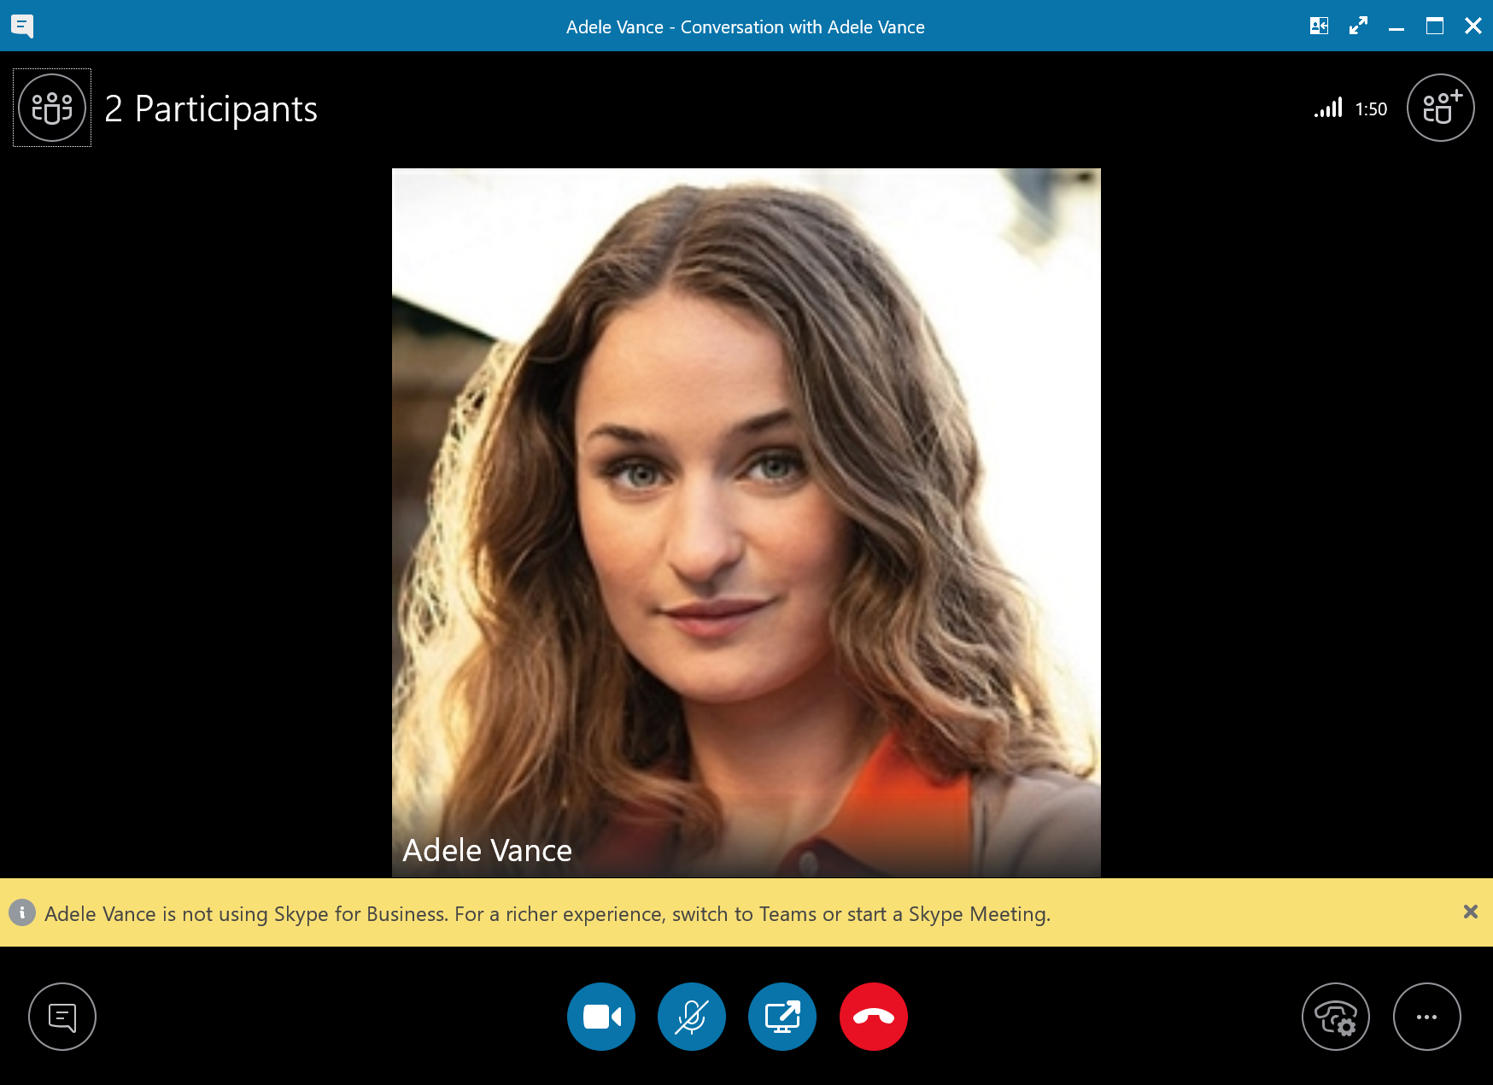
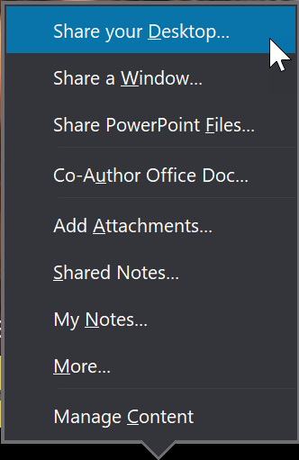
Native Interop
(desktop sharing from SFB)
  Skype user communicating with Teams user
    Skype for Business user has established an interop thread
    Communicating via chat/audio/video
    Skype user notified recipient is not using Skype for Business (yellow banner)
  Desktop Sharing
    Skype user invokes desktop sharing as they normally would
Notes:
SFB must be Current Channel (July 2018)+
Escalation from the Teams side is planned for CY18Q3.

Slide 25
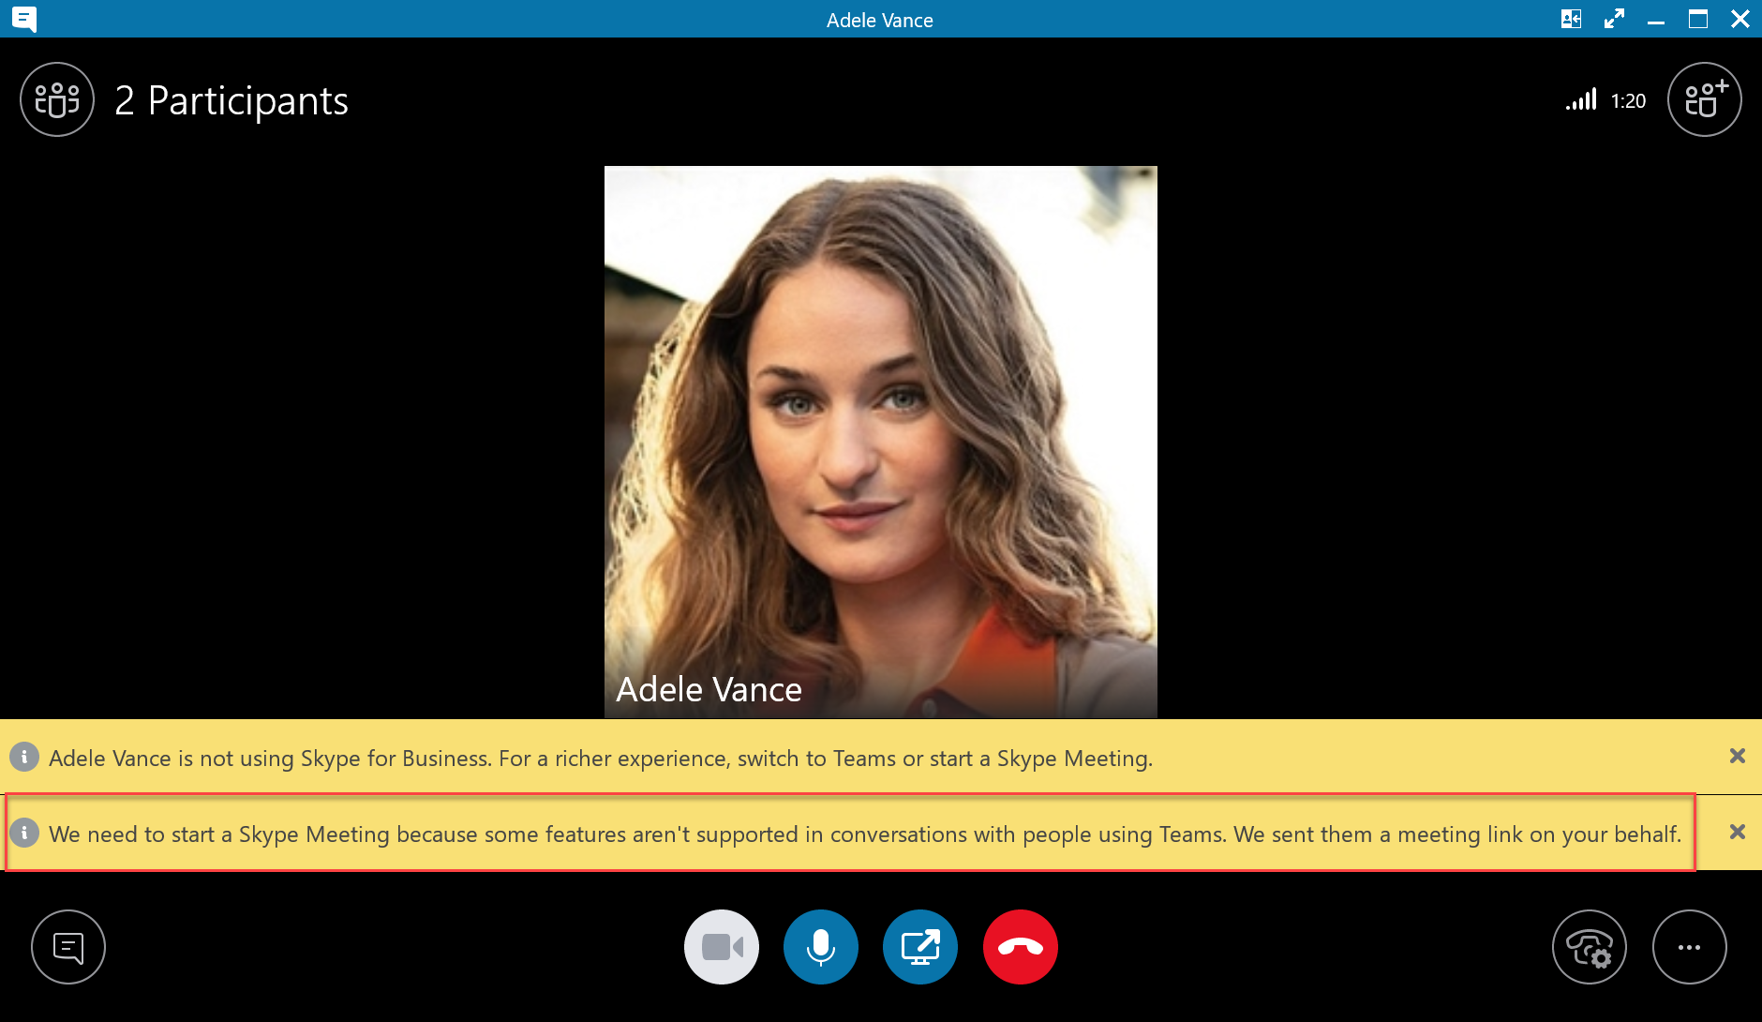
Native Interop
(desktop sharing from SFB)
  Skype user communicating with Teams user
    Skype for Business user has established an interop thread
    Communicating via chat/audio/video
    Skype user notified recipient is not using Skype for Business (yellow banner)
  Desktop Sharing
    Skype user invokes desktop sharing as they normally would
    Skype Meeting automatically started
    Skype user is moved into Skype Meeting transparently
Notes:
SFB must be Current Channel (July 2018)+
Escalation from the Teams side is planned for CY18Q3.

Slide 26
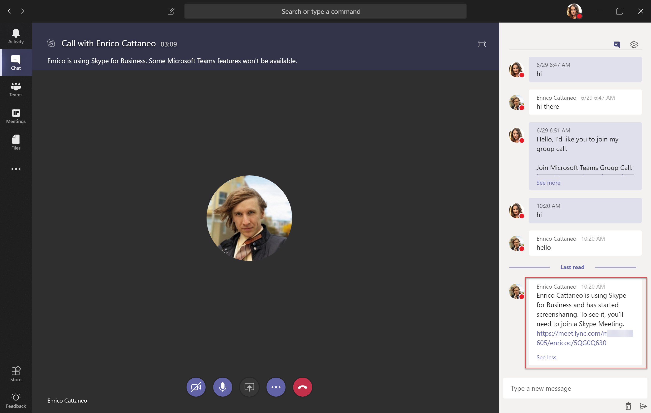
Native Interop
(desktop sharing from SFB)
  Skype user communicating with Teams user
    Skype for Business user has established an interop thread
    Communicating via chat/audio/video
    Skype user notified recipient is not using Skype for Business (yellow banner)
  Desktop Sharing
    Skype user invokes desktop sharing as they normally would
    Skype Meeting automatically started
    Skype user is moved into Skype Meeting transparently
    Teams user will receive meeting join link through chat
    Teams user will join meeting in Skype (using full client or web app)
Notes:
SFB must be Current Channel (July 2018)+
Escalation from the Teams side is planned for CY18Q3.

Slide 27
Upgrading from Skype for Business (default recommendation)

Slide 28


Skype for Business Organization: User perspective
Full Side by Side Approach
+
Enable Teams with full functionality
Allow users to experience full benefits of Teams digital transformation soonest
All users must run both Skype for Business and Teams clients at all times until they become Teams Only
Notes:
We should add a noter aboutl leave outlook addin till m\eting trooms are updated

Slide 29
Skype for Business Organization: User perspective
Full Side by Side Approach
Teams
(Drive saturation while Skype for Business still on)
Teams Only
SFBO
Teams & SFBO
Side by side
Deploy Teams side-by-side with Skype for Business (online or on-premises) with full* functionality in Teams
Drive rapid adoption across your organization to saturation, while leaving Skype for Business enabled.
Once you have reached a saturated level of adoption and all room devices are deemed Teams compatible, upgrade all users to Teams-only as rapidly as possible.

Slide 30
Upgrade for more complex orgs

Slide 31



Upgrade from a user’s point of view
For on-prem & hybrid orgs, or if end users are confused having two apps with same functionality
+
Starting point: User is in Skype for Business with Communications (chat, meeting scheduling, calling) functionality
Introduce Teams to the user, without Communications functionality
  All calls & chat continue to land in and originate from Skype for Business
  User can explore net new functionality of Teams (Channels/apps/etc)
Switch Communications functionality over to Teams
  Non-upgraded users and upgraded users rely on interop to communicate

Slide 32

Org perspective: Upgrade without overlapping functionality
For on-prem & hybrid orgs, or if end users are confused having two apps with same functionality
Variation A: No prior Teams usage
Original User Population
Begin Teams Pilot
Migration Complete
Pilot expands
SFB
SFB
With Teams (no UC)
Teams
  During migration, users in Skype for Business can communicate with users in Teams via interop
  Presence is aligned with routing
  Skype for Business users can use non-UC functionality in Teams prior to upgrade

Slide 33
Org perspective: Upgrade without overlapping functionality
For on-prem & hybrid orgs, or if end users are confused having two apps with same functionality
Variation B: Organizations with prior Teams usage
Begin Teams Pilot
Original User Population
Migration Complete
Pilot expands
SFB
SFB
With Teams (no UC)
Teams
SFB
and Teams

Slide 34


Upgrade from a user’s point of view: Meetings First
For on-prem & hybrid orgs, that will move to Meetings First before going Teams Only
+
+
Begin State: User is in Skype for Business with UC functionality.
Introduce Teams to the user, without UC functionality, previously described
Switch Meetings scheduling functionality from Skype for Business to Teams
  Up to this point, all calls and chats initiate from and land in Skype for Business
Upgrade fully to Teams-Only Teams
  Chat & Calling between Upgraded (Teams-Only) users and all other users relies on interop

Slide 35
Org’s upgrade journey – more complex org – Meetings First
For on-prem & hybrid orgs, or if end users are confused having two apps with same functionality
Skype for Business with Teams without UC
Start user population
Meetings First
Meetings First Pilot
Deployment
Begin Teams-Only Pilot
Migration complete
Skype for Business
Meetings First
Skype for Business
with Teams (no UC)
Meetings
First
Teams

Slide 36
DEMO

Slide 37
Interop

Slide 38
Interop 101
Q
Why is Interop Needed?
A
Teams-Only users must always be able to communicate with Skype for Business users
  Intra-org during migration
  Cross-org scenarios during and after migration
Q
What is Interop?
A
Communication between a Skype for Business user and a Teams user
  Chat & Calling
    1-on-1 only
    Plain text chat only
    Capabilities are identical in federated and in-tenant cases
Q
Are there Interop Pre-requisites?
A
  With on-premises, a Skype for Business hybrid topology required
Teams-user must be homed in Skype for Business Online to enable 1-on-1 interop chats & calls
  Teams users with Skype for Business homed on-premises do not have interop nor ability to federate via Teams
  Advanced features
  (Partially available today)
    Creating a meeting provides full featured experience for all users
    Group chat/group call achieved via auto-invite meeting escalation
    File/screen sharing achieved via auto-invite meeting escalation
    Availability:
      Skype for Business to Teams auto-invite available now
      Teams to Skype for Business TBD

Slide 39

In-tenant interop flows (conceptual) – 1
SfB* and TeamsOnly
SfB*
(online)
Gateway
(online only)
TeamsOnly
SfB*
(on-prem)
Hybrid topology
(required)
Gateway
(online only)
TeamsOnly
User A
User B
User A
User B
SfB
SfBO
SfB
SfBO
GW
GW
T
T
T
T
Scenario #1:
Skype Online user talking to Teams Only user
Scenario #2:
Skype On-premises user talking to Teams Only user
  Interop relies on a “shadow” SfBO account for the TeamsOnly user
  SfB* refers to any of the following modes: SfBOnly, SfBWithTeamsCollab, and SfBWithTeamsCollabAndMeetings

Slide 40
In-tenant interop flows (conceptual) – 2
Islands and TeamsOnly
Islands
(online)
Gateway
(online)
TeamsOnly
Islands
(on-prem)
Hybrid topology
(required)
Gateway
(online)
TeamsOnly
User A
User B
User A
User B
SfB
SfBO
SfB
SfBO
GW
GW
T
T
T
T
Scenario #3a:
Islands mode [Skype account online] - talking to Teams Only user
Scenario #3b:
Islands mode [Skype account on-premises] - talking to Teams Only user
  Interop relies on a “shadow” SfBO account for the TeamsOnly user

Slide 41
In-tenant interop flows (conceptual) – 3
Islands and SfB*
Islands
(online)
Gateway
(online)
SfB*
Islands
(on-prem)
Hybrid topology
(required)
Gateway
(online)
SfB*
User A
User B
User A
User B
SfBO
SfB
SfB
SfB
GW
GW
T
T
T
T
Scenario #4a:
Islands mode [Skype account online] - talking to Skype for Business online user
Scenario #4a:
Islands mode [Skype account on-premises] - talking to Skype for Business online user
  SfB* refers to any of the following modes: SfBOnly, SfBWithTeamsCollab, and SfBWithTeamsCollabAndMeetings
User A does not have an SfBO account, cannot use the interop GW, no interop, can’t use Teams to communicate with SfB* mode users, must use SfB

Slide 42
Interop chat and calling routing (new 1:1 chats or calls)
Routing determined by
Recipient’s mode
Originator’s client of choice
Where the originator’s Skype for Business is homed (online or on-prem)
Whether the conversation is possible – i.e. excludes communication from Teams account that has Skype for Business homed on-prem
SfB* represents any of the following modes:
SfBOnly, SfBWithTeamsCollab, SfBWithTeamsCollabAndMeetings
Indicates an interop conversation

Slide 43
Thank you!

